Slide 1
5. Confidence

Slide 2

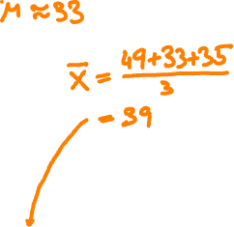


59
62
57
59
55
55
53
56
44
56
46
49
53
50
52
46
46
44
51
48
52
38
46
45
45
39
42
49
45
44
39
41
37
46
40
44
41
40
32
44
49
35
36
31
32
46
30
35
45
41
33
33
37
42
39
34
35
37
43
38
42
27
36
39
38
37
33
33
40
44
25
32
28
43
33
37
40
39
30
25
25
24
32
23
23
31
28
19
34
39
23
37
32
24
28
33
22
31
24
33
30
31
26
25
34
20
23
28
21
28
22
15
31
25
21
21
29
29
21
15
20
29
30
20
29
18
27
19
36
16
15
32
24
13
15
20
15
20
26
26
16
15
29
27
6
12
16
5
7
11
13
15
histogram of X
(n = 3)

Slide 3
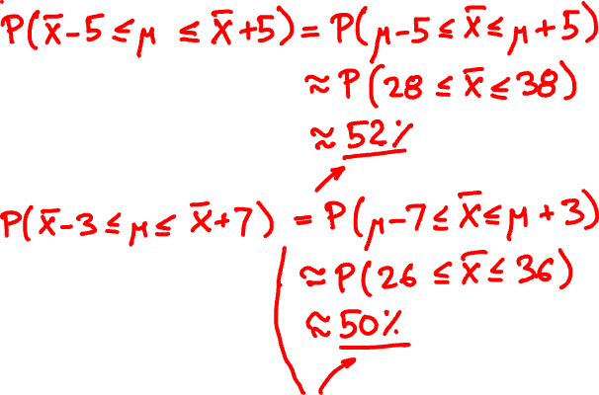


Slide 4
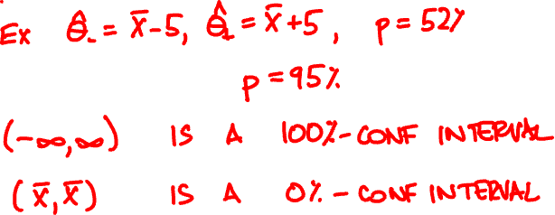

Confidence intervals
^
^
A p-confidence interval is a pair Θ₋, Θ₊ so that
^
^
P(θ is between Θ₋ and Θ₊) ≥ p

Slide 5

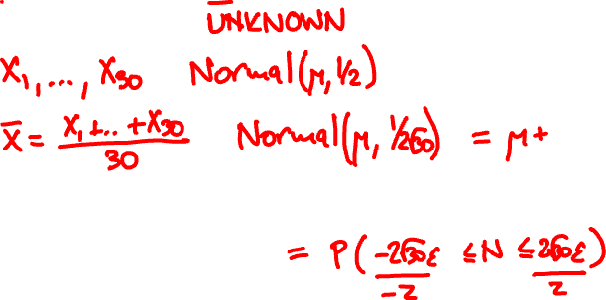




Give a 95%-confidence interval for the mean from 30 Normal(μ, ½) samples

Slide 6
Confidence interval for normal mean
X₁, X₂, …, X_{n} are Normal(μ, σ) samples
sample mean X is Normal(μ, σ/√n)
P(X – z–σ/√n ≤ μ ≤ X + z₊σ/√n)
= P(–z₊ ≤ Normal(0, 1) ≤ z –)
95% confidence for z – = z₊ ≈ 1.96

Slide 7
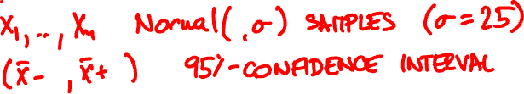
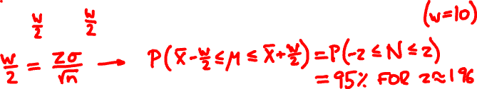
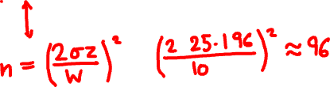
How many Normal(μ, 25) samples do you need for a 95% confidence, width 10 interval?

Slide 8

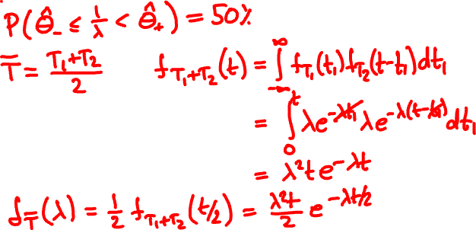
My last emails arrived 25 and 58 minutes ago. Give a 50%-confidence interval for the mean

Slide 9
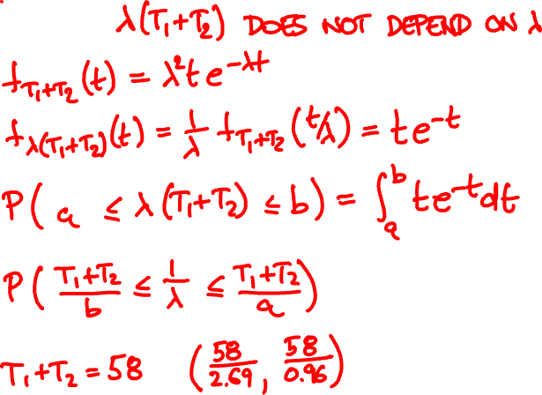




Slide 10
Confidence interval for exponential mean
X₁, X₂, …, X_{n} are Exponential(λ) samples
nλX is Erlang(n, 1) (a.k.a. Gamma(n, 1))
P(nX/z₊ ≤ 1/λ ≤ nX/z –)
= P(z– ≤ Erlang(n, 1) ≤ z₊)
https://homepage.divms.uiowa.edu/~mbognar/applets/gamma.html

Slide 11
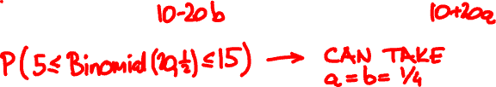
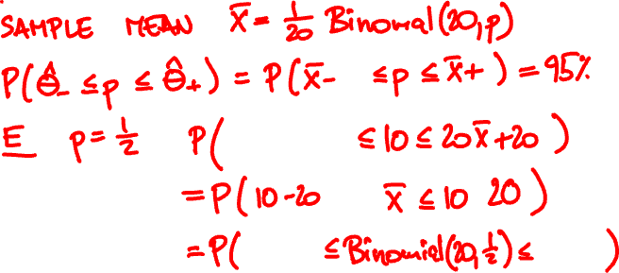

Come up with a 95% confidence interval for p from 20 Indicator(p) samples
https://homepage.divms.uiowa.edu/~mbognar/applets/bin.html

Slide 12


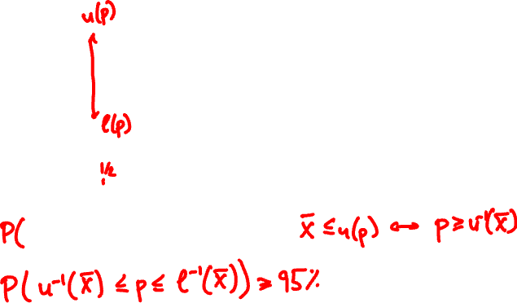
X
p
p
X

Slide 13


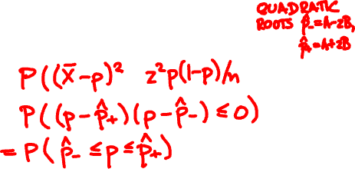




Confidence interval for Indicator(p)
P(A – zB ≤ p ≤ A + zB ) ≈ P(–z ≤ Normal(0, 1) ≤ z)
X + z²/2n
√X(1 – X)/n + z²/4n²
A =
B =
1 + z²/n
1 + z²/n

Slide 14
n = 20, 95% level
p
X
explicit calculation
formula via normal approximation

Slide 15
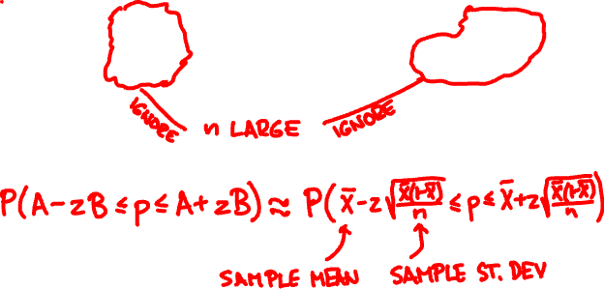
Simplified confidence interval
P(A – zB ≤ p ≤ A + zB ) ≈ P(–z ≤ Normal(0, 1) ≤ z)
X + z²/2n
√X(1 – X)/n + z²/4n²
A =
B =
1 + z²/n
1 + z²/n

Slide 16
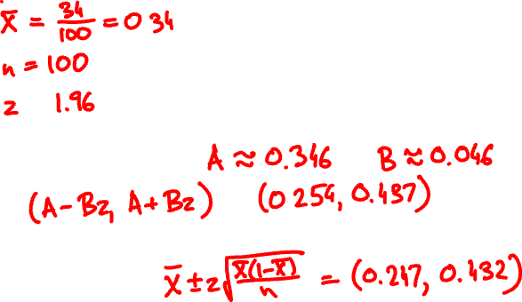

34 of 100 Indicator(p) samples came out positive. Give a 95% confidence interval.

Slide 17
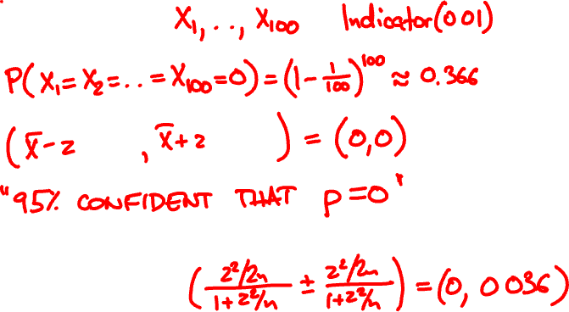



What does it say for 100 Indicator(0.01) samples?

Slide 18
n = 20, 95% level
p
X
traditional formula
simplified formula

Slide 19
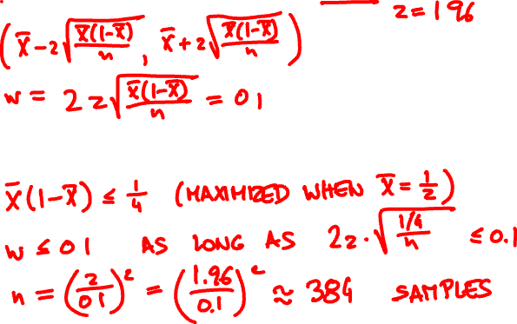

How many (simplified) samples do you need to get a 0.1 width interval with 95% confidence?

Slide 20



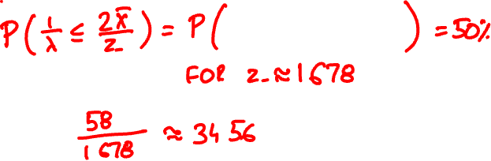
My last emails arrived 25 and 58 minutes ago. Give a 50%-upper confidence bound for mean

Slide 21
Confidence bound
A p-upper confidence bound is Θ so that
P(θ ≤ Θ) ≥ p
A p-lower confidence bound is Θ so that
P(θ ≥ Θ) ≥ p

Slide 22

Confidence bound for normal mean
X is mean of n Normal(μ, σ) samples
P(μ ≤ X + zσ/√n) = P(Normal(0, 1) ≥ –z)
P(μ ≥ X – zσ/√n) = P(Normal(0, 1) ≤ z)
95% confidence for z ≈ 1.645

